Slide 1
Hobbies
by Zarifullin Emil 8A

Slide 2
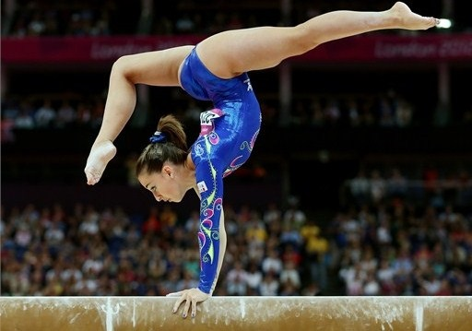
ACROBATICS

Slide 3
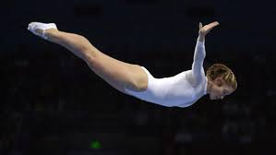
AKD
Acrobatics appeared many years ago. Originally it was called the acrobats not only the athletes were involved into sport, but also a variety of rope-walkers, dancers. Only at the beginning of the XX century this kind of sport is considered to be professional.
Acrobatics has many varieties, and today I want to talk about trampolinig and tumbling.

Slide 4
AKD Section
AKD
Trampolining
Tumbling

Slide 5
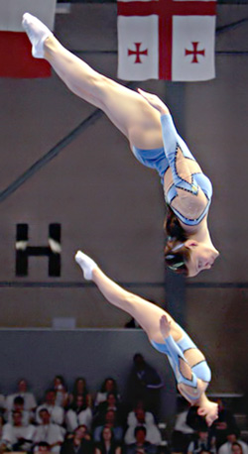
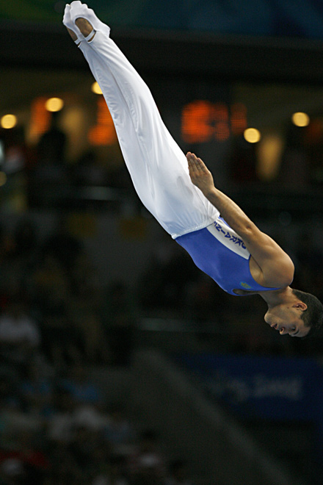
Trampolining
Trampoline competitions include such sports disciplines as: synchronized jumps, individual jumps,, tumbling track, double mini-tramp.

Slide 6
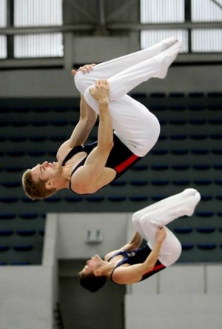
Trampoling
Competitive trampolining routines consist of combinations of 10 contacts with the trampoline bed combining varying rotations, twists and shapes with take-off and landing in one of four positions:
1) Feet jumps
2) Seat jumps
3) Front jumps
4) Back jumps

Slide 7
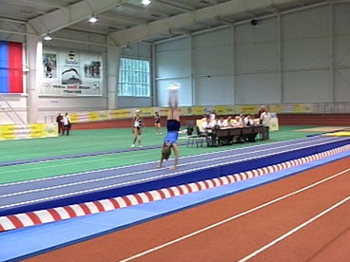
Tumbling
Tumbling is also known as power tumbling, is an acrobatic discipline which combines some of the skills of artistic gymnastics on the floor with those of trampolining. It is practised on a 25-metre long spring track (also called a tumbling track or rod floor). It was developed from tumbling performances performed by entertainers from very early times but as a sport is now codified, regulated and judged and performed using standardised special equipment.
Competitors perform two passes, each containing eight skills including twisting somersaults along the track ending in a 'dismount' skill. The dismounting skill is often another double or triple full or a double or triple back somersault, which can also include some extra twists.

Slide 8
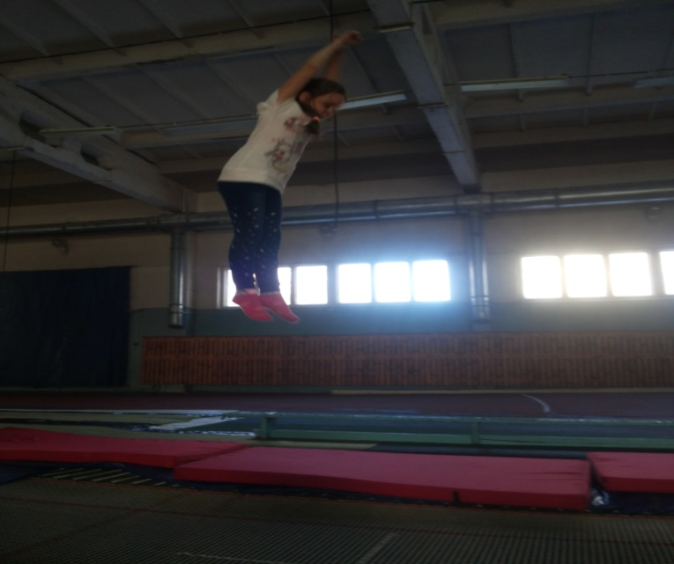
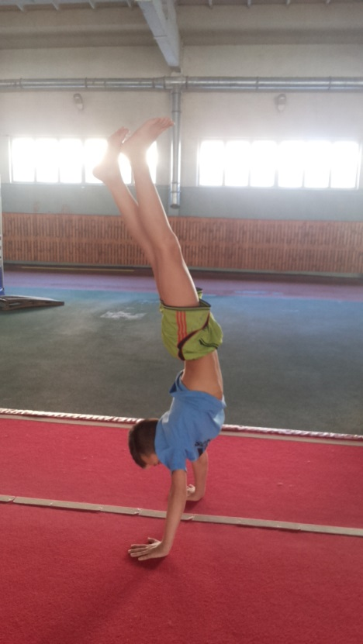
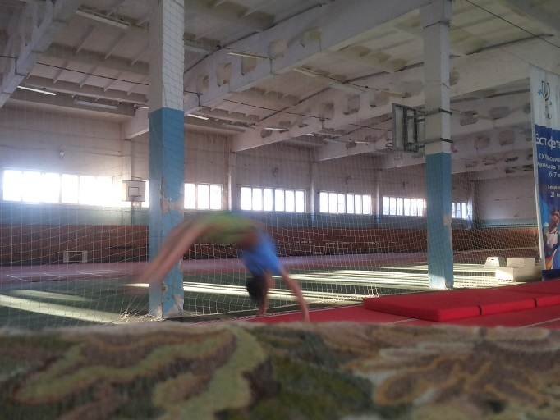
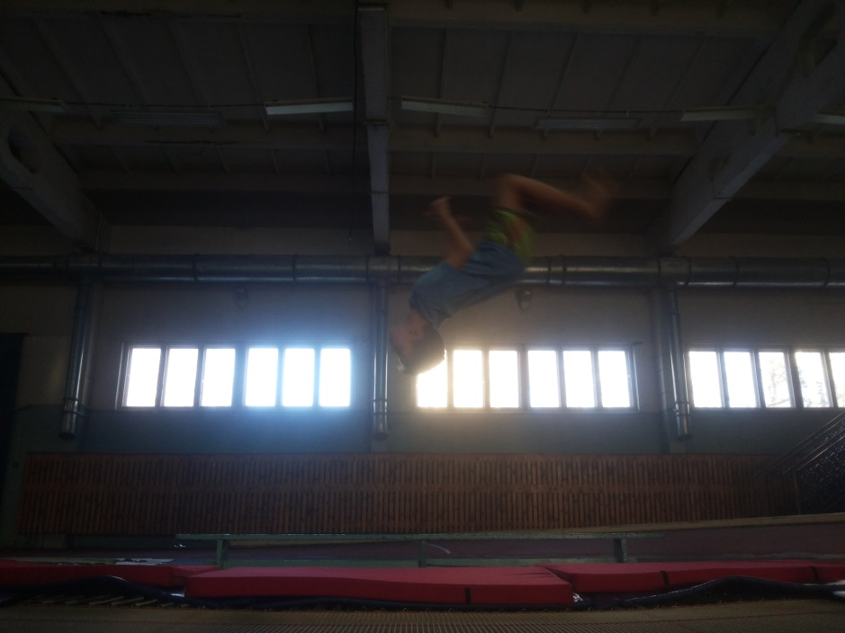
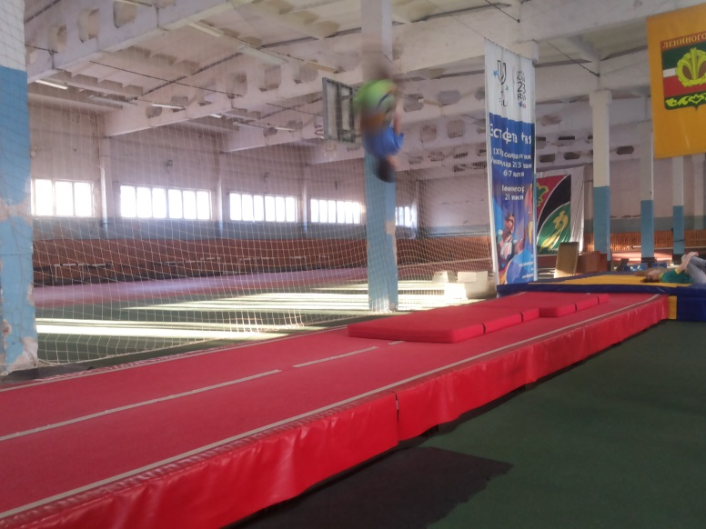
In our city there is also tumbling

Slide 9

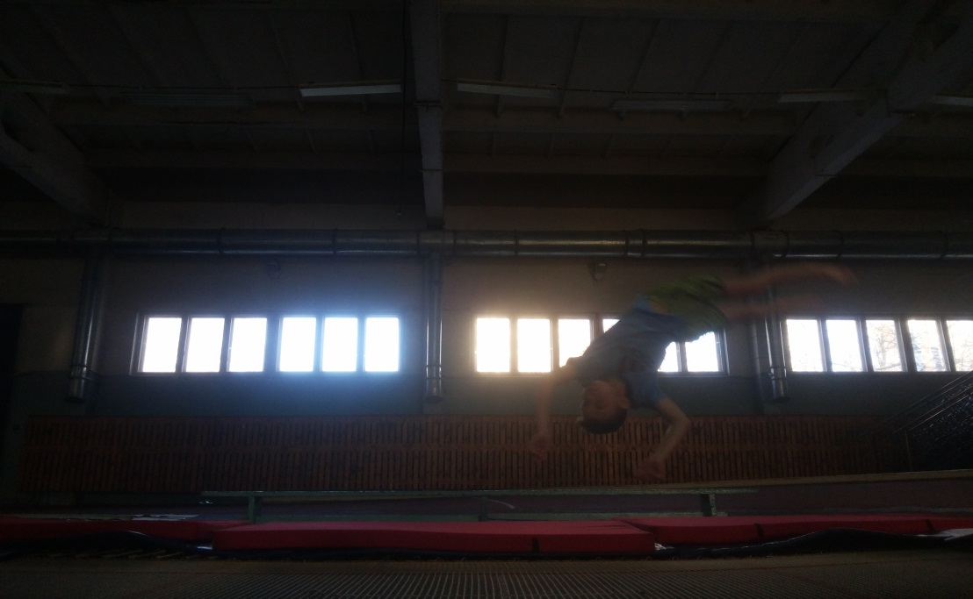
Where you can do acrobatics?
If you want to be strong, healthy, beautiful, or you want to make new friends, you can come to the first trainig.Sport school is located at 8 Shashin Street.

Slide 10
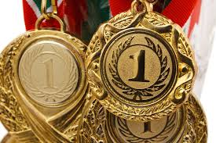
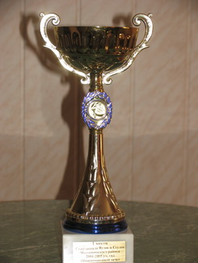
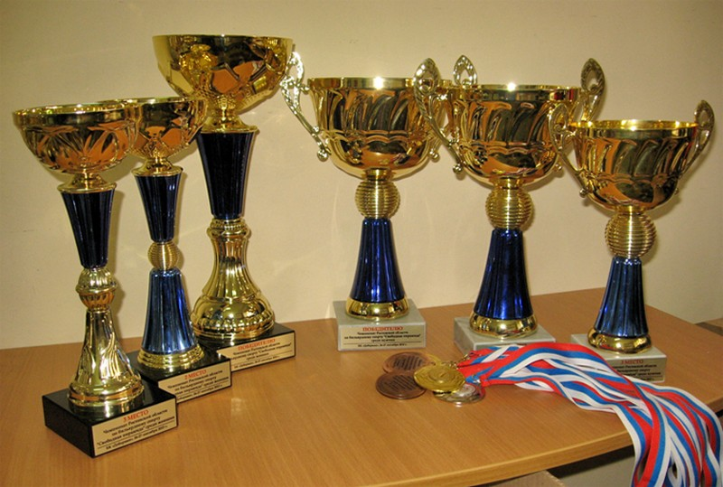
Our work always brings rewards!

Slide 11
Thank you for your attention!!!

